Slide 1
Unleashing Derby’s Potential Igniting the Midlands Engine and Delivering on Levelling Up in the East
26 July 2023
September 2021

Slide 2
THE AGENDAS ON A MAP
2
Derby: Igniting the Midlands Engine
3
UK Rail Reset
Levelling Up
1

Slide 3
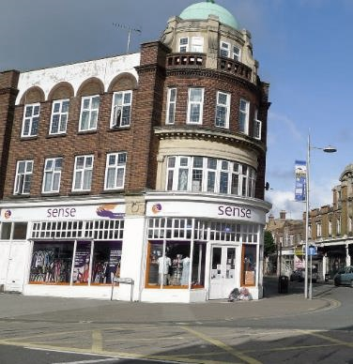
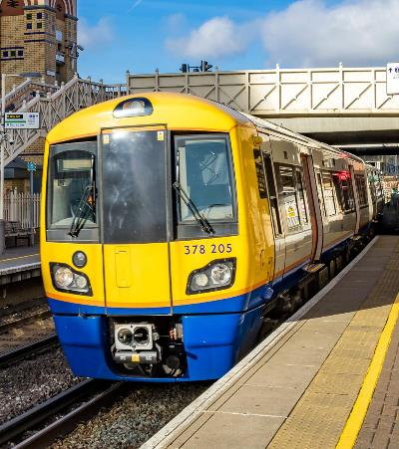
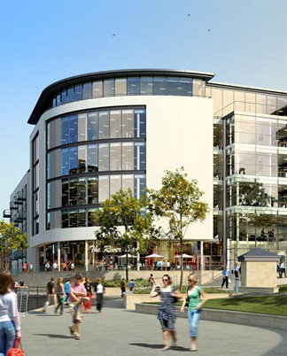
THREE CONVERGING AGENDAS
1
2
3
Levelling Up
Derby’s Growth Agenda
Derby: Igniting the Midlands Engine
Levelling Up
UK Rail Reset

Slide 4
1
Levelling Up
The UK Government has a programme of Levelling Up and Relocation of the Civil Service is integral to this
1
UK Civil service employs over 450,000 people
Over the past decade the London Civil Service has grown and neglected many regions - with 1 in 2 HQs in London and 76% of Senior Civil Servants still based there
2
The Civil Service is committed to reversing this by relocation of 22,000 staff from London and the South East, including senior posts
3

Slide 5
1
Levelling Up
Relocation is now being driven through the prism of Levelling Up :
New Skills: increased focus on digital, knowledge and IT, and operational delivery
New Opportunities: getting government closer to communities and industries it serves
New organisations: to deliver on national transformation and tackle global challenges

Slide 6
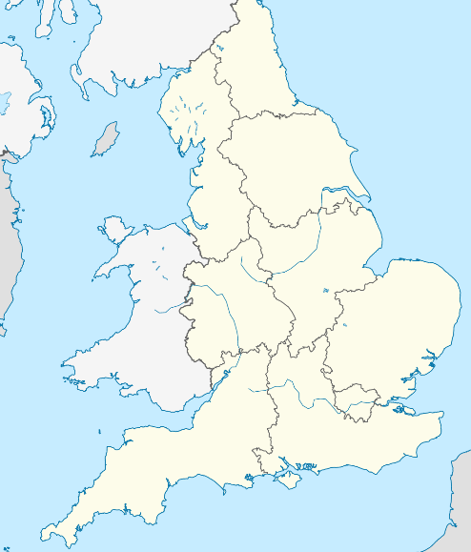
1
Levelling Up – Progress So Far
1
Levelling Up is a “work in progress”
Government has already committed 3 major relocations to the West Midlands; 2 to Yorkshire and 2 to the North East
2
The East Midlands is the only region north of England without a clear government relocation commitment
3
4
East Midlands offers significant ROI for Levelling Up

Slide 7
1
Levelling Up – Progress So Far
Derby offers significant ROI for Levelling Up the East Midlands
1
It’s the right size

Slide 8
1
Levelling Up – Progress So Far
Derby offers significant ROI for Levelling Up the East Midlands
1
It’s the right size

Slide 9
1
Levelling Up – Progress So Far
Derby offers significant ROI for Levelling Up the East Midlands
1
It’s the right size
Derby has a strong manufacturing base, white collar jobs would complement, diversify and lead to higher graduate retention
2

Slide 10
1
Levelling Up – Progress So Far
Derby offers significant ROI for Levelling Up the East Midlands
1
It’s the right size
Derby has a strong manufacturing base, white collar jobs would complement, diversify and lead to higher graduate retention
2
3
Yet Derby has fewer Civil Servants than almost any city in the UK

Slide 11
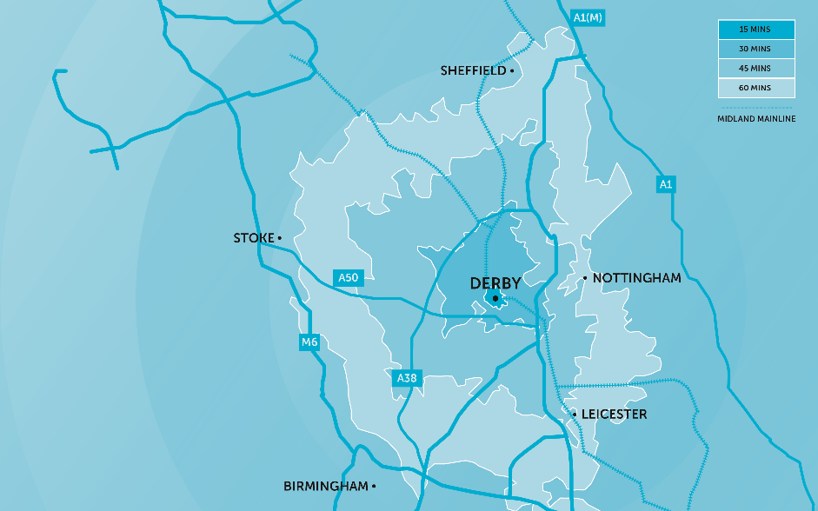
1
Levelling Up – Progress So Far
Derby offers significant ROI for Levelling Up the East Midlands
“A Derby relocation would Level Up Derby, Derbyshire, Nottingham and Leicester.”
1
It’s the right size
Regional Stakeholder
Derby has a strong manufacturing base, white collar jobs would complement, diversify and lead to higher graduate retention
“Being located in Derby, the benefits of employment stretch across the region, including to Nottingham”
2
Industry Stakeholder
3
Yet Derby has fewer Civil Servants than almost any city in the UK
“The CBI recently merged its Midlands offices and decided on the East Midlands because there are just a lot more businesses based there.”
4
Investing in Derby is investing in the whole East Midlands
Regional Stakeholder

Slide 12
THREE CONVERGING AGENDAS
1
2
3
Levelling Up
Derby’s Growth Agenda
Derby: Igniting the Midlands Engine
Levelling Up
UK Rail Reset

Slide 13
UK rail had its challenges before the pandemic, but these trends have magnified dramatically over the past year:
2
A lack of innovation is central. Working practices have been unchanged for decades. System incentives are contradictory
Complex, distant and adversarial relationships between operators, suppliers and government do not meet the needs of passengers, freight customers or taxpayers
UK Rail Reset
Trends in this direction were accelerated by COVID-19 measures and the national lockdowns

Slide 14
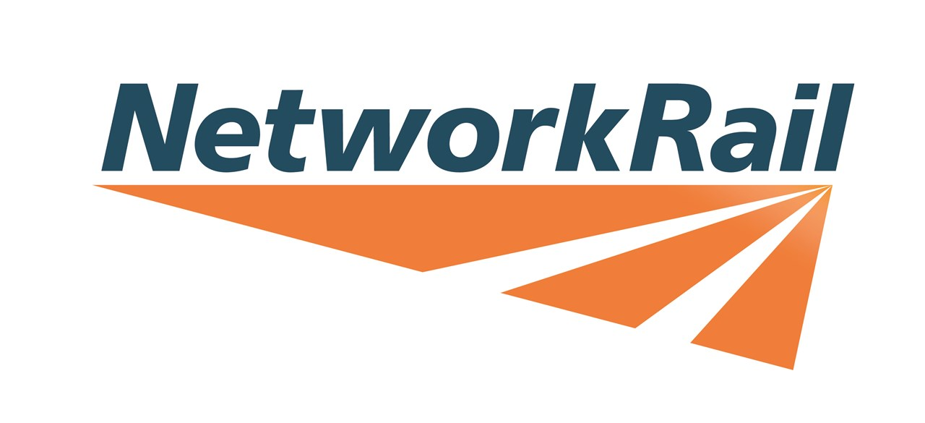
2
These developments have led to a step change in how rail strategy is considered by government , transforming from inward-facing to outward and collaboration focused
GREAT BRITISH RAILWAYS
UK Rail Reset

Slide 15
2
GREAT BRITISH RAILWAYS
The rail sector in the UK and the new Great British Railways organisation will face 3 major challenges or ambitions in the future:
System-wide understanding and a more strategic approach to planning and delivery
1
Maximising domestic capabilities and improving export goods performance in the sector
2
UK Rail Reset
Innovation and re-orienting towards net-zero-carbon
3

Slide 16
System-wide understanding and strategic approach
Derby’s Blueprint:
1
Highest concentration of cross-sector rail stakeholders in the UK (inc. design manufacturing and delivery)
Highly specialist 10,000 plus strong workforce in manufacturing
Government Ambition:
“Derby is the highest output site for [us] anywhere; it is the only place in the country where you can design and build a train in one site.”
Passenger-centric experience
“The challenge post-96 is that people have gone into silos; we need to create opportunities for teams to work creatively close together … Derby would give you a rounded view of the whole rail industry.“
Long term working and cultural partnerships across sectors
Strategic direction and accountability for error
ALSTOM
INDUSTRY STAKEHOLDER

Slide 17
Maximising national capabilities and improving exports
Derby’s Blueprint:
2
Two-thirds of rolling stock manufactured in Derby
UK leader in manufacturing jobs and related grad skills
Local orgs increasingly in multi-modal transport with huge investments in data management and analytics regionally
Government Ambition:
Explore UK potential in advanced control, energy management, whole life assets and customer experience
World-class rail research at Rail Research Centre
“One of the obvious strengths for Derby is innovation; already a very tech-oriented city and region.”
Improve digital and data usage in ticketing
Doubling export capability by 2025
EAST MIDLANDS RAILWAY

Slide 18
Maximising national capabilities and improving exports
Derby’s Blueprint:
2
Two-thirds of rolling stock manufactured in Derby
UK leader in manufacturing jobs and related grad skills
Local private sector in multi-modal transport with huge investments in data management and analytics regionally
“The private sector is well placed to use knowledge, experience and skills to identify new opportunities to improve passenger satisfaction, achieve cost efficiencies and offer new services and features that people want.“
World-class rail research at Rail Research Centre
“One of the obvious strengths for Derby is innovation; already a very tech-oriented city and region.”
WILLIAMS-SHAPPS PLAN FOR RAIL
EAST MIDLANDS RAILWAY

Slide 19
Local private sector in multi-modal transport with huge investments in data management and analytics regionally
Work Wallet – All in One Health and Safety Software (Derby)
Balfour Beatty – digital innovation division based in Derby
CoMech - specialist in calibration, design, manufacture, and supply of critical safety equipment with a data element (Derby)
Resonate – traffic and transport management data (Derby)
MRX Technologies – Siemens technology division in Derby

Slide 20
Innovation and re-orienting towards net-zero-carbon
Derby’s Blueprint:
3
Cluster of companies with research into net-zero (e.g. Toyota TDREAM & Rolls Royce Small Modular Reactors)
Universities demonstrator on net-zero ambition in rail fuel
Local leader in data and analytics innovation
Government Ambition:
Reduction of all transport carbon emissions
“Derby’s great strength is its collaboration with ALL businesses, from manufacturing to technology. Derby could become the UK’s first smart region.”
“[Our] collaborative agreement is unique in UK and globally… It builds on Derby having an imaginative approach... Derby has a reputation for being innovative.”
Alternative solutions where electrification impossible
Resolve fuel supply challenges e.g. in hydrogen
MIDLANDS ENGINE
TOYOTA

Slide 21
2
AMBITIONS
THE FUTURE
The Derby Vision is de facto the 21st hub for UK rail – investment will enhance existing industry/ government collaborations in Defence and Nuclear in Abbey Wood and Sellafield
1
2
3
UK Rail Reset

Slide 22
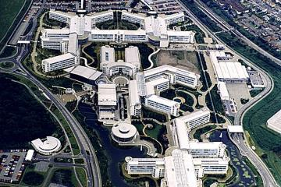
ABBEY WOOD
Ministry of Defence - Defence Equipment & Support campus near to Bristol (14,000 FTE)
Collaborative with Rolls Royce and BAE Systems (largest suppliers)
Integrated project teams partnered for long term delivery
Cultivation of in-house skills and innovation

Slide 23
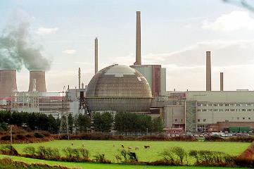
SELLAFIELD
Cluster of Nuclear Decommissioning Authority with industry, supply chain and academia (10,000 FTE)
Project collaboration over 100+ years
Focus on local SME supply chains
On-site “Project Academy” with Uni of Cumbria for skills mapping

Slide 24
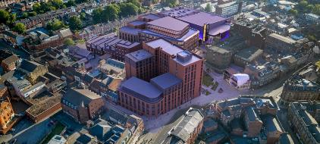
DERBY RAIL STRATEGY & INNOVATION CENTRE?

Slide 25
2
AMBITIONS
THE FUTURE
The Derby Vision is de facto the 21st hub for UK rail – investment will enhance existing industry/ government collaborations in Defence and Nuclear in Abbey Wood and Sellafield
1
2
3
UK Rail Reset

Slide 26
THREE CONVERGING AGENDAS
1
2
3
Levelling Up
Derby’s Growth Agenda
Derby: Igniting the Midlands Engine
Levelling Up
UK Rail Reset

Slide 27
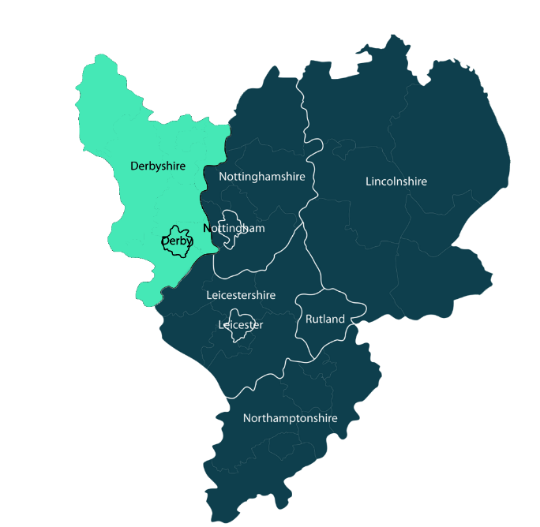
3
Derby’s Assets
Derby is the only true rail manufacturing and industrial cluster in the UK
It holds ingredients vital to the UK’s railway transformation…

Slide 28
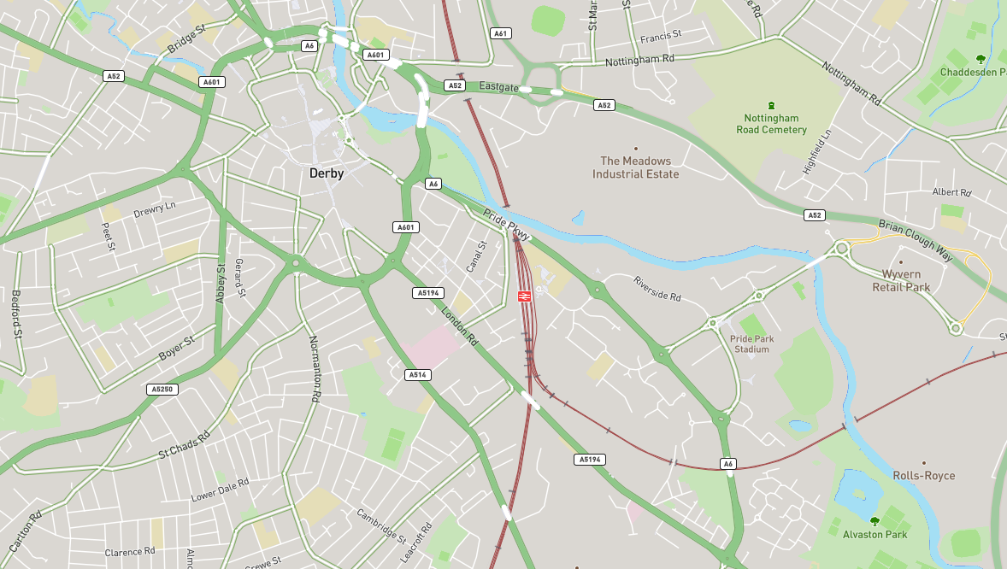
3 miles
1 mile
3
Derby is already central to UK Rail’s Future
Train Leasing
Derby
Station
Engineering
Operator
⌀ 1 mile
Consultancy
Construction
Manufacture
8 miles
3 miles

Slide 29
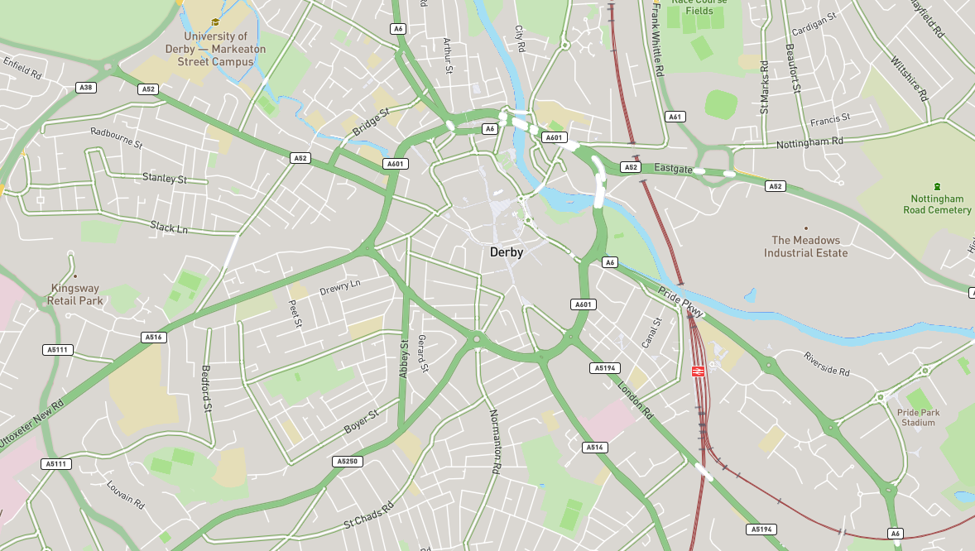
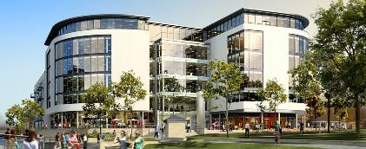
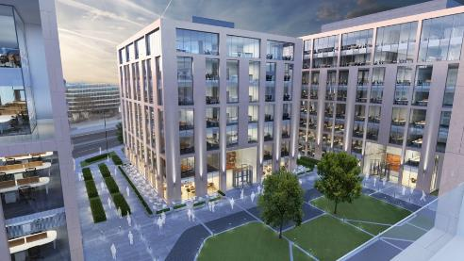
3
Places for Growth and Collaboration
ONE CATHEDRAL GREEN
BECKETWELL
TRAFFIC STREET

Slide 30
These converging agendas hold transformational potential
VISION
OBJECTIVES
Levelling Up
Derby: Igniting the Midlands Engine
Unifying fulcrum for the Midlands Engine
1
Supporting the ambition of the UK Rail Sector
2
3
Levelling up East Midlands
UK Rail Reset

Slide 31
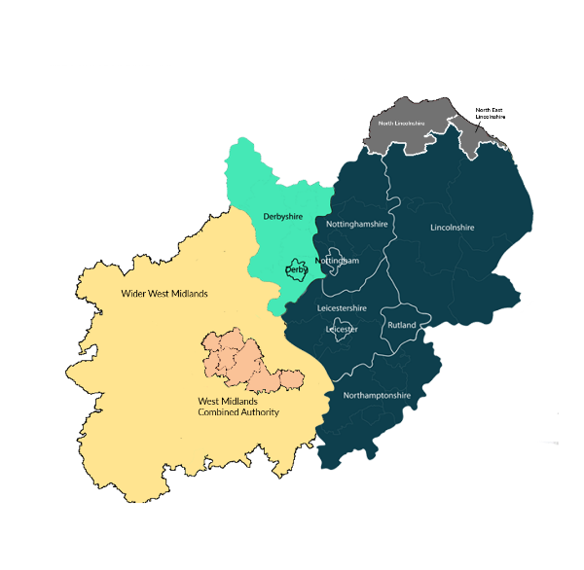
Unifying fulcrum for the Midlands Engine
1
Government have invested heavily in the Engine in the form of jobs, Transport and decision making however mostly on the West
WMCA boundaries covers only 37% of total Midlands population
Critical need to reconnect the other 6.7m population of the Midlands with Levelling Up

Slide 32
Unifying fulcrum for the Midlands Engine
1
The pan regional Midlands Engine offers advantages of scale
Transport is strong in both regions with distinct strengths in each (Automotive in West and Rail in East) offering potential for integration and global competitiveness in innovation, workforce, IP and supply chains

Slide 33
Unifying fulcrum for the Midlands Engine
1
There is potential to link together major transport investments and clusters in rail and automotive
It would link together business activity in both regions (CBI - more members in East than West)
The Freeport network will link together investments in other locations such as Tees Valley and Grimsby, creating huge national economic potential – East Midlands has rail links to almost every other Freeport and will act as a defacto freight centre for the entire UK

Slide 34
Unifying fulcrum for the Midlands Engine
1
DARLINGTON
MANCHESTER
1hr 42m to Derby
1hr 35m to Derby
A Derby-based centre could provide a counterpoint to bring together the Midlands Engine and connect with wider Levelling Up nationwide
WOLVERHAMPTON
1hr to Derby
Dual MHCLG HQ
BIRMINGHAM
30m to Derby
COVENTRY
DERBY
DFT 1m sqft Super Campus, inc Highways England and others
1hr to Derby
Homes England

Slide 35
Supporting the ambition of the UK Rail Sector
2
A joint decision-making campus across Derby and Birmingham will:
1
Bring DFT closer to industry in the rail and automotive sectors
Provide maximum advantage to DFT and Civil Service staff in travel to work time from two complementary hub locations
2
3
Double Departmental access to future workforce
DERBY
Support on-shoring strategic rail capability, exporting excellence and delivering HS2, Levelling Up and zero carbon
4

Slide 36
3
Levelling up East Midlands
Government investment in Derby provides maximum return for Levelling Up through:
A new base for Government and growing Derby’s civil service headcount (currently lowest of all regional cities)
1
Accelerating local growth - moving rail decision-making to the centre of rail manufacturing aligns with local priorities & enable multiplier effect
2
3
Unlocking wider city centre regeneration
Creating more extensive career ladders, including administrative and executive roles, boosting retainment of graduates and increasing social mobility
4

Slide 37
These converging agendas hold transformational potential
VISION
OBJECTIVES
Levelling Up
Derby: Igniting the Midlands Engine
Unifying fulcrum for the Midlands Engine
1
Supporting the ambition of the UK Rail Sector
2
3
Levelling up East Midlands
UK Rail Reset

Slide 38
CONCLUSION AND SUMMARY
VISION
SUMMARY POINTS
Derby: Igniting the Midlands Engine
Derby can deliver maximum ROI on Levelling Up and relocation
Levelling Up
1
Derby’s raw assets can transform the UK Rail sector and meet government ambition
2
Investment will unlock growth both Derby and the eastern half of the Midlands Engine
3
UK Rail Reset

