Slide 1
Facing the Future
Leveraging Challenges for Local Growth
Facing the Future
Leveraging Challenges
For Local Growth
`
Facing the Future
Leveraging Challenges for Local Growth

Slide 2
Breaking Barriers Innovations
Facing the Future Programme
Launch of the Breaking Barriers Innovations Playbook
June 2016
February 2017
June 2017
March 2018
May 2018
September 2018
November 2018
April 2019
June 2019
June 2019

Slide 3
Breaking Barriers Playbook
Action Plan
Stakeholders
Building Blocks
Barriers
Aims
The Goal
Co-designed with
service users
1
Local Government
Resident & Community Engagement
Co-Design
2
Short Term Priorities
NHS CCGs, Trusts & GPs
Workforce and skills plan
2
Place-based approach that delivers
Housing Associations
No Blueprint
Innovation and learning
from industry and CVS
Strategic Alignment
3
Agree Dominant Strategy
Residents & Third Sector
1
Different Systems
Education Providers
Siloed Budgets
Workforce for the future
Skills, Competence, & Culture
Affordable & sustainable
4
3
Central Government
Fear & Risk of Failure
Service Integration
Service Transformation
Governance route map
4
5
Social / Private Sector Housing

Slide 4
Current BBI Programme
1
Cornwall
2
Solent
3
Somerset
4
NE Essex
5
Kent
Employment and aspiration
Housing and health
Social Isolation
Tackling ageing through retaining youth
Prevention for marginalised health groups

Slide 5
Facing the Future
The Programme

Slide 6
Shared Vision
1
Utilise public service requirements to drive long-term industrial base and growth
Shape and position cross-public sector industry partnership to deliver this built around an agreed strategic outcome
2
Shared Action Plan
1
Outline review of procurement, infrastructure and asset opportunities to drive the change
Identify and engage opportunities for leverage i.e. attracting FDI, national investment, supporting local enterprise and – where appropriate – government support
2

Slide 7
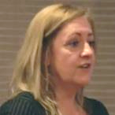
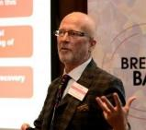
Programme Advisory Panel
Assets and infrastructure
Innovation / SME growth
Expertise: Co-Chair / Strategic Leadership
Expertise: Regeneration
Expertise: Strategic Partnership Development
Chief Executive, Disruptieve
Former minister and current Chair of Social Work England
Former Chief Executive, Hinckley & Bosworth Council
Lord Patel of Bradford OBE
Steve Atkinson
Andrea Winders
Expertise: NHS, health transformation
Expertise: Industry and Innovation
Expertise: Strategy and Economic Development
Director at the Leicestershire Partnership NHS Trust
Former Director Exeter City Council
Formerly Number 10 Policy Unit and Director of Enterprise, University College London
Dr Jonathan Bashford
Richard Ball
Timothy Barnes
Community Engagement
Expertise: Housing
Expertise: NHS transformation
Expertise: Central Government & Civil Service
Programme Director for Community Innovations Enterprise LLP
Former Chief Executive, National Housing Federation
Former Senior Civil Servant in Dept. for Transport and Ministry of Defence
Sherife Hasan
Simon Lydiard
David Orr

Slide 8
Place-Based Solution
Defines the real challenges and identifies the necessary strategic interventions
1
Brings all important anchor institutions to the table
2
3
Attracts net inward investment and supports local growth

Slide 9
Place-Based Solution

Slide 10
Stakeholders
Building Blocks
Aims
The Goal
Challenges
NHS
Local Authority
?
Central Government
Place-based approach that delivers Local Growth
?
Education
Blue Light Services
?
Industry
?
CVS

Slide 11
Stakeholders
NHS
Local Authority
Central Government
Education
Blue Light Services
Industry
CVS

Slide 12
NHS (Trusts, Foundation Trusts, CCGs, Integrated Care Systems)
Central Government (departments, NDPBs, executive agencies)
Education (schools, universities, FE)
Local Authority
Industry (SMEs, innovators, market leaders)
CVS (Housing, care)
Blue Light Services

Slide 13
NHS
Local Authority
Central Government
Education
Blue Light Services
Industry
CVS

Slide 14
NHS Long Term Plan
NHS
1
Local Authority
System Priorities
Shift from Acute to Community
Integrated Care Models
Investment in technology, workforce and patient pathways
Partnership Opportunities
Collaborative investment with STP funding on capital heavy investment projects
Joint asset Plans
Senior living and extra care investment models
Workforce planning – recruitment, development and retention
Central Government
Education
Blue Light Services
Industry
CVS

Slide 15
NHS
2
Topol Review
Local Authority
90% of NHS jobs will require digital skills within 20 years
1
Central Government
50% of NHS workforce will still be in the NHS in 15 years but digital literacy is not a priority
Education
2
Blue Light Services
Less than a quarter of the population has so far registered for online services with a GP
Industry
3
CVS

Slide 16
Industrial Strategy
3
NHS
Local Authority
4 Grand Challenges:
Artificial Intelligence and data
Ageing society
Clean growth
Future of mobility
Government/
Industry Growth Clusters:
Higher Education
Industry
Government (including central)
Central Government
Education
Blue Light Services
UKHO Geospatial Centre Taunton
Industry
CVS

Slide 17
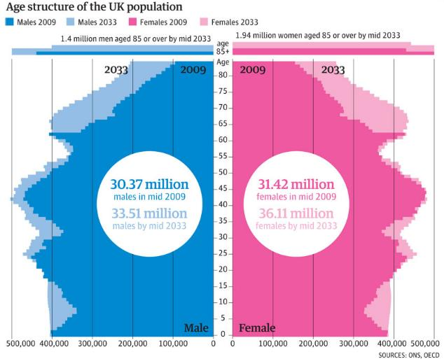
4
Increased demand:
NHS
Local Authority
Central Government
Education
Blue Light Services
Industry
CVS

Slide 18
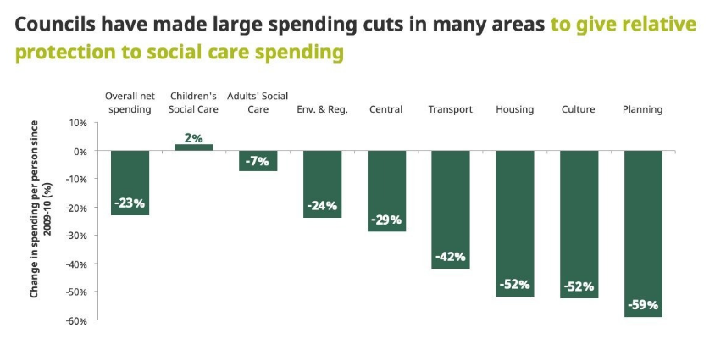
5
Increased demand:
NHS
Local Authority
Central Government
Education
Blue Light Services
Industry
CVS

Slide 19
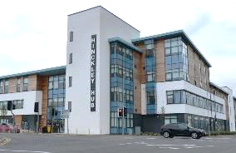
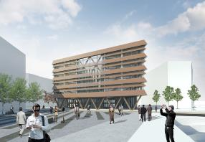
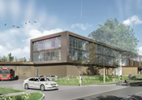
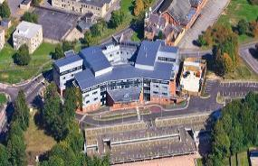
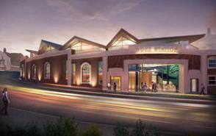
6
Estates and Asset led Transformation
NHS
Local Authority
Central Government
Education
Hinckley
Sunderland
Lincoln Blue Light
Blue Light Services
Industry
CVS
Frimley Health Hub
Whitehaven

Slide 20
7
Collapse in traditional outsourcing
NHS
The outsourcing model is broken and driving suppliers large and small out of business
Local Authority
Central Government
It is failing to build the long-term skills the UK economy needs – with 150k FTEs shortages in Construction and 250k in the NHS
Education
Blue Light Services
There is a gap between the work SMEs perform in the market (55%) and the proportion of government spend they win (10.5%)
Industry
CVS

Slide 21
Stakeholders
Building Blocks
Aims
The Goal
Challenges
NHS
Local Authority
?
Place-based approach that delivers Local Growth
Central Government
Strategic Alignment
?
Education & Universities
1
Blue Light Services
?
Industry
?
CVS

Slide 22
Stakeholders
Building Blocks
Aims
The Goal
Challenges
Defines dominant strategy for growth around major challenges for anchors to solve,
NHS
Local Authority
Comprehensive strategic evaluation of all existing plans and key planning documents
?
1
Place-based approach that delivers Local Growth
Central Government
Strategic Alignment
?
Education & Universities
Focused enquiry 1:1 interviews with system leaders (LA, NHS, HE, CVS etc)
1
2
Blue Light Services
?
Facing the Future workshop
with multisectoral mentors- agree programme focus based on evidence
Industry
3
?
CVS

Slide 23
Stakeholders
Building Blocks
Aims
The Goal
Facilitated Workshop
Challenges
What is the challenge which would have the greatest impact across the entirety of the system?
NHS
Local Authority
?
1
Place-based approach that delivers Local Growth
Central Government
Lord Patel of Bradford OBE
What is the intervention that is best-suited to a system approach as opposed to traditional siloed activity?
Strategic Alignment
?
Education & Universities
1
2
Blue Light Services
?
Which challenge is also a magnet for growth?
Industry
3
?
CVS

Slide 24
Stakeholders
Building Blocks
Aims
The Goal
Challenges
NHS
Local Authority
?
Place-based approach that delivers Local Growth
Central Government
Strategic Alignment
?
Agree Dominant Strategy
Education & Universities
1
Blue Light Services
?
Industry
?
CVS

Slide 25
Stakeholders
Building Blocks
Aims
The Goal
Challenges
NHS
Shared
Planning
Local Authority
2
?
Place-based approach that delivers Local Growth
Central Government
Strategic Alignment
?
Agree Dominant Strategy
Education & Universities
1
Blue Light Services
?
Industry
?
CVS

Slide 26
How can the Dominant Strategy be supported by existing plans, procurement needs and objectives across anchor organisations;
Stakeholders
Building Blocks
Aims
The Goal
Challenges
Establish Facing the Future Working Group reflective of;
Public Services
Industry
HE
Central Government
NHS
Shared
Planning
1
Local Authority
2
?
Place-based approach that delivers Local Growth
Central Government
?
Strategic Alignment
High level review of 15 year future skills and infrastructure requirements
Education & Universities
Agree Dominant Strategy
1
2
Blue Light Services
?
Existing procurement pipelines and strategies
3
Industry
?
Where is the growth opportunity?
CVS
4

Slide 27
Stakeholders
Building Blocks
Aims
The Goal
Challenges
NHS
Shared
Planning
Co-Design
Local Authority
2
?
Place-based approach that delivers Local Growth
Central Government
Strategic Alignment
?
Agree Dominant Strategy
Education & Universities
1
Blue Light Services
?
Industry
?
CVS

Slide 28
Stakeholders
Building Blocks
Aims
The Goal
Challenges
NHS
Shared
Planning
Co-Design
Local Authority
2
?
Place-based approach that delivers Local Growth
Central Government
Strategic Alignment
?
Agree Dominant Strategy
Education & Universities
1
Blue Light Services
?
Programme Development
3
Industry
?
CVS

Slide 29
Stakeholders
Attracting investment and supporting local growth via:
Building Blocks
Aims
The Goal
Challenges
NHS
Shared
Planning
Co-Design
Gap analysis on skills for the future
Local Authority
2
Research and early screening activity (1:1 interviews)
?
1
1
Place-based approach that delivers Local Growth
Central Government
Shortlist presented and agreed by local authority
Sector profiling- top 30
?
Strategic Alignment
2
Agree Dominant Strategy
Education & Universities
1
2
Blue Light Services
Top 10 invited to Industry and Innovation Solutions Session
?
Programme Development
3
Industry requirements- workforce & workplace, lifestyle & logistics
3
3
Industry
?
CVS

Slide 30
Stakeholders
Building Blocks
Aims
The Goal
Challenges
NHS
Shared
Planning
Co-Design
Local Authority
2
?
Place-based approach that delivers Local Growth
Central Government
Strategic Alignment
?
Agree Dominant Strategy
Education & Universities
1
Blue Light Services
?
Shared Vision
Programme Development
3
Industry
?
CVS

Slide 31
Stakeholders
Building Blocks
Aims
The Goal
Challenges
NHS
Shared
Planning
Co-Design
Local Authority
2
?
Place-based approach that delivers Local Growth
Central Government
Strategic Alignment
?
Agree Dominant Strategy
Education & Universities
1
Blue Light Services
?
Shared Vision
Programme Development
3
Industry
Attracting investment into the challenge
?
CVS
4

Slide 32
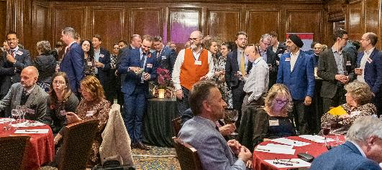
Stakeholders
The Shared Vision
Building Blocks
1
Aims
The Goal
Challenges
NHS
Initial Engagement and Industry Launch Day
Shared
Planning
2
Co-Design
Local Authority
2
?
Place-based approach that delivers Local Growth
Central Government
Strategic Alignment
?
Agree Dominant Strategy
Education & Universities
1
Blue Light Services
?
Resource for the future
Programme Development
3
Industry
Action Plan with agreed, shared ownership
3
Attracting investment into the challenge
?
CVS
4

Slide 33
Stakeholders
Building Blocks
Aims
The Goal
Challenges
NHS
Shared
Planning
Co-Design
Local Authority
2
?
Place-based approach that delivers Local Growth
Central Government
Strategic Alignment
?
Agree Dominant Strategy
Education & Universities
1
Blue Light Services
?
Shared Vision
Programme Development
3
Industry
Attracting investment into the challenge
?
Investment Pipeline
CVS
4

Slide 34
Shared Vision
1
Utilise public service requirements to drive long-term industrial base and growth
Shape and position cross-public sector industry partnership to deliver this built around an agreed strategic outcome
2
Shared Action Plan
1
Outline review of procurement, infrastructure and asset opportunities to drive the change
Identify and engage opportunities for leverage i.e. attracting FDI, national investment, supporting local enterprise and – where appropriate – government support
2

Slide 35
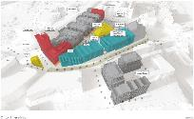
Facing the Future Approach:
Potential Applications:
1
Regeneration
6-month programme with self contained 5-week Phase1
1
2
Procurement
Match-funded 1/3rd from locality / LA with internal project resource
2
3
Adult Social Care
Opportunity to bring in local SMEs
3
4
Preventative Care

